Slide 1
String Processing
Examples

Slide 2
String Functions
Concatenation
Insert
Remove
Extract/substring
Find and Replace
Trim
Pad
Case
Split/Tokens

Slide 3


String Concatenation

Slide 4

Inserting Strings into Strings

Slide 5

Removing Characters from a String

Slide 6
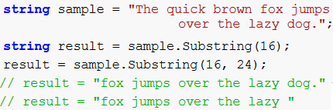
Extracting Text from a String

Slide 7

Search and Replace

Slide 8
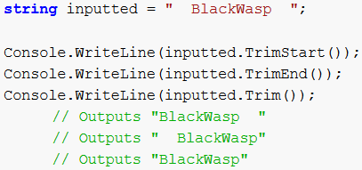
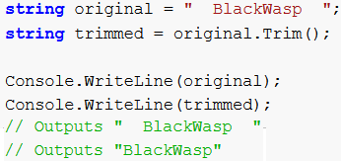
Trimming

Slide 9
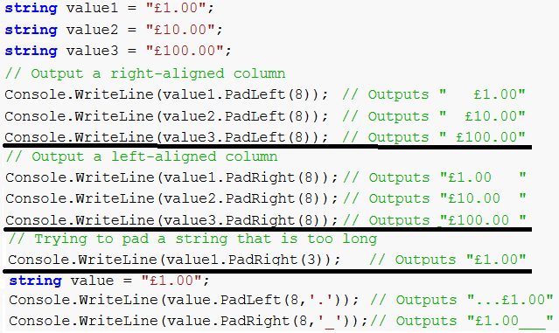
Padding

Slide 10
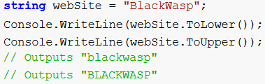
Text Case Conversion

Slide 11
Split -1
Example | Output
string s = "there is a cat"; string[] words = s.Split(' '); foreach (string word in words) Console.WriteLine(word); | There Is a cat

Slide 12
Split -2
Example | Output
using System; using System.Text.RegularExpressions; class Program { static void Main() { string value = "cat\r\ndog\r\nanimal\r\nperson"; string[] lines = Regex.Split(value, "\r\n"); foreach (string line in lines) Console.WriteLine(line); } } | cat dog animal person

Slide 13
Split -3
Example | Output
// The directory from Windows const string dir = @"C:\Users\Saeed\KITE\Strings"; // Split on directory separator string[] parts = dir.Split('\\'); foreach (string part in parts) Console.WriteLine(part); | C: Users Saeed KITE Strings

Slide 14
Split -4
Example | Output
// // Split on multiple characters using new char[] already created. // string t = "That is a cute cat, man"; char[] c = new char[]{ ' ', ',' }; string[] s = t.Split(c); | That is a cute cat man

Slide 15
Split -5
Example | Output
string value1 = "man,woman,child,,,bird"; char[] delimiter1 = new char[] { ',' }; ================================================ string[] array1 = value1.Split(delimiter1, StringSplitOptions.None); foreach (string entry in array1) Console.WriteLine(entry); =============================================== string[] array2 = value1.Split(delimiter1, StringSplitOptions.RemoveEmptyEntries); foreach (string entry in array2) Console.WriteLine(entry); | ============== man woman child bird ============== man woman child bird

